Slide 1
Genesis: Evolving Optimal Cache Schedule
Research Presentation
Optimizing Cache Schedules for Efficient Diffusion Model Training.
💡 The rapid growth of diffusion models demands efficient training methods, but their computational requirements pose significant optimization challenges.
Genesis: Evolving Optimal Cache Schedule for Diffusion Models | --Manuscript Draft-- | Manuscript Number:

Slide 2
Motivation
1/12
Diffusion models have revolutionized image generation by producing high-quality results
However, their deployment remains constrained by slow inference due to sequential denoising steps
Training free acceleration methods like DeepCache exploit feature redundancy across timesteps
Determining an optimal caching schedule still remains a challenging task

Slide 3

Figure 1: Overall Motivation
2/12
Figure 1 illustrates the overall motivation of the proposed

Slide 4
Related Work
3/12
Diffusion models have achieved high-quality generative performance
However, they require iterative denoising steps, making inference slower and more resource-intensive
Early acceleration strategies focused on reducing the number of sampling steps using improved solvers
More recent approaches explore architectural modifications or knowledge distillation to smaller student models

Slide 5
Methodology
4/12
We propose an evolutionary optimization framework to improve the caching strategy in diffusion models
Instead of relying on fixed and uniform caching intervals, our approach searches for adaptive schedules
To achieve this, we used an Island Model
The complete pipeline is described in Figure 2

Slide 6
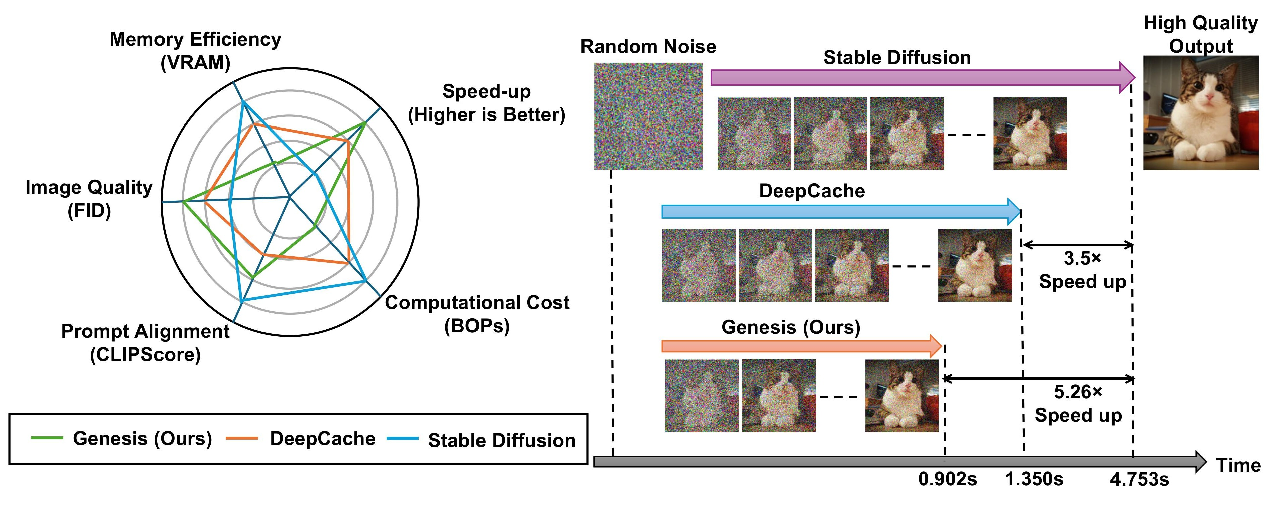
Figure 2: Overview of the Proposed Framework
5/12
Figure 1: Comparison of Genesis, DeepCache, and Stable Diffusion. Genesis provides better overall performance across multiple metrics and

Slide 7
Problem Formulation
6/12
Diffusion models generate images through a sequential denoising process over T timesteps
At each timestep, the model refines the image progressively
We define caching schedule as a sequence of timesteps in which the full evaluation is performed

Slide 8
Background
7/12
Diffusion models are widely known for producing high-quality images
At higher level, they work by gradually corrupting data and then learning how to reverse that corruption
In the forward process, noise is added step by step to an image
In the reverse process, a neural network learns to remove noise

Slide 9
Method
8/12
We propose an evolutionary optimization framework to improve the caching strategy in diffusion models
We used an Island Model to search for adaptive schedules
The complete pipeline is described in Figure 2
We also introduce diffusion-based caching strategies

Slide 10
Table 2: Comparison of Different Caching Strategies
9/12
Method | Fitness ↑ | Convergence
Simple GA + Standard Ops Island Model + Standard Ops Simple GA + Proposed Ops Island Model + Proposed Ops | 92.45 94.50 95.25 96.88 | Slow Medium Medium Fast
Table 2

Slide 11
Results
10/12
We compared our proposed caching strategy with existing methods
Our results show that our approach provides better overall performance across multiple metrics
We also present a qualitative comparison between different diffusion models and caching strategies

Slide 12
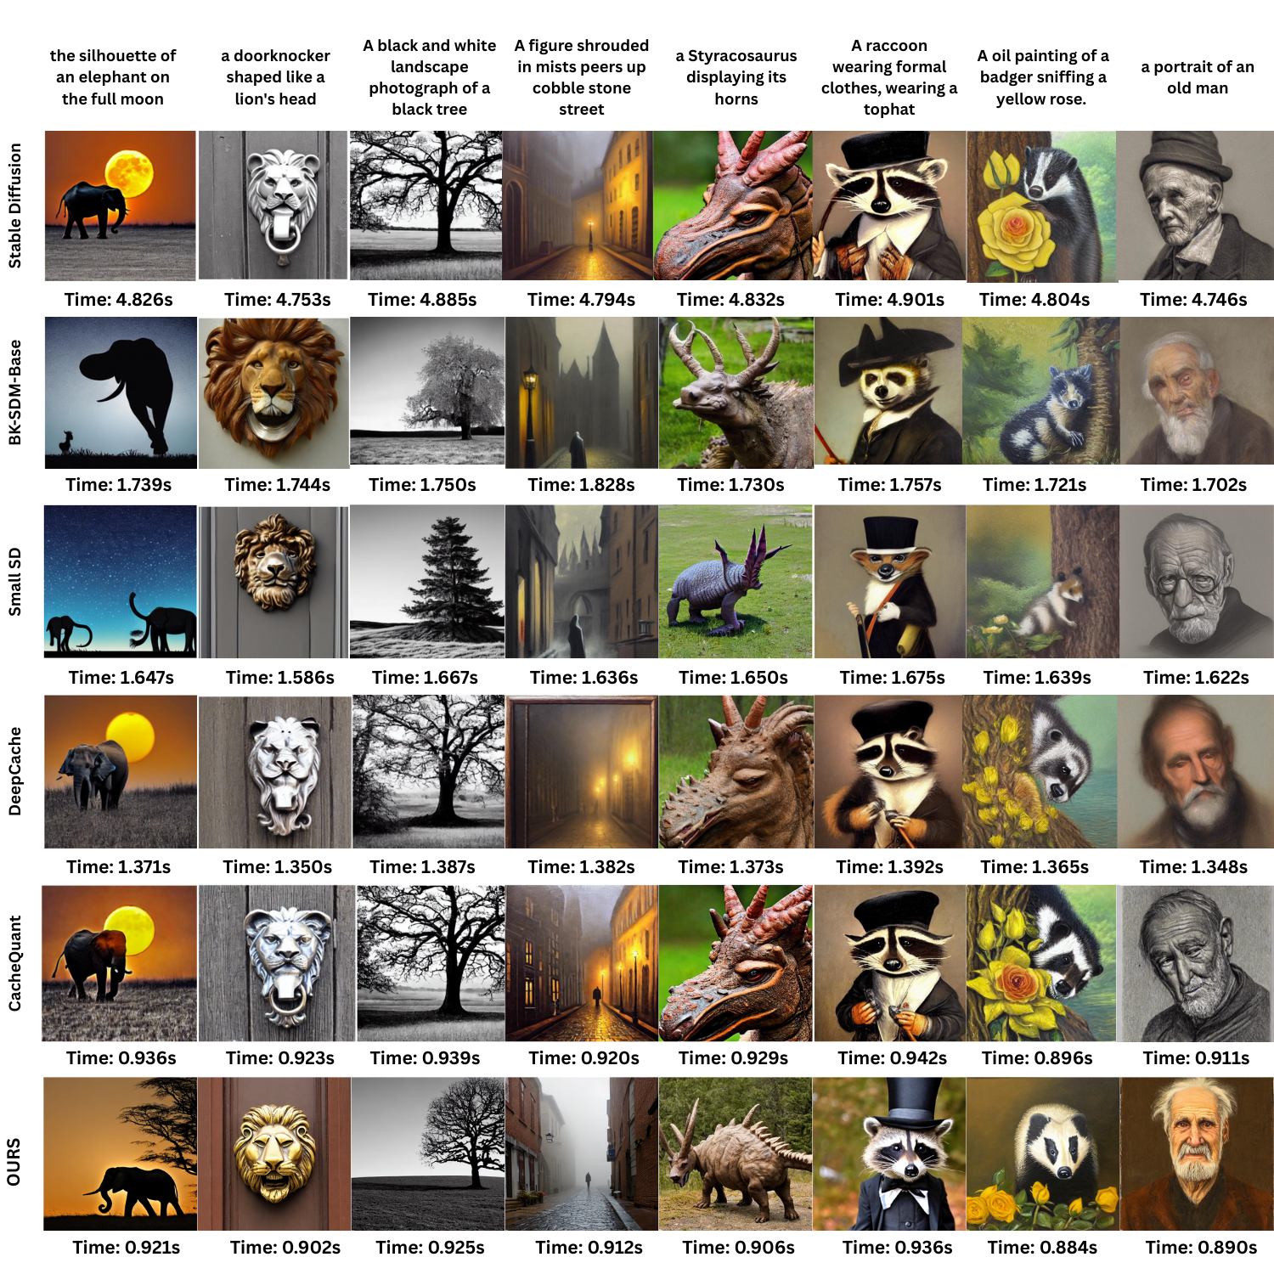
Figure 6: Qualitative Comparison
11/12
Figure 6: Qualitative comparison across diffusion models and caching strategies. Images generated from multiple text prompts are shown

Slide 13
Conclusion
12/12
We proposed an evolutionary optimization framework to improve the caching strategy in diffusion models
Our approach provides better overall performance across multiple metrics
We also presented a qualitative comparison between different diffusion models and caching strategies

Slide 14
Thank You
Genesis: Evolving Optimal Cache Schedule for Diffusion Models | --Manuscript Draft-- | Manuscript Number:

